Slide 1
Agile Discussion Document

Slide 2
Agenda
Introduction
The Importance of business agility
Agile delivery – key concepts
Delivering on the promise business agility – key lessons
Agile Transformation - Case Study – Kaching
Approach to agile transformation

Slide 3
Agenda
Introduction
The Importance of business agility
Agile delivery – key concepts
Delivering on the promise business agility – key lessons
Agile Transformation - Case Study - Kaching
Approach to agile transformation

Slide 4














An extensive study of 424 companies spanning 22 industries across 32 year period identified only a handful (<5%) were sustained high performers*
*Based on survival rates and total shareholder return

Slide 5
The Study found that the sustained high performing corporations were able to adapt by utilising a set of integrated routines allowing them to make timely, effective and sustained responses to environmental change.
Routine
Description
1
Strategising
How top management teams establish an aspirational purpose, develop widely shared strategy, and manage the climate and commitment to execution.
2
Perceiving
The process of broadly, deeply and continuously monitoring the environment to sense changes and rapidly communicate these perceptions to decision makers, who interpret and formulate appropriate responses.
3
Testing
How the organization sets up, runs and learns from experiments
4
Implementing
How the organization maintains its ability and capacity to implement changes, both incremental and discontinuous, as well as its ability to verify the contribution of execution to performance.

Slide 6
Testing
3
Testing Routine
Setting up the Test | Establishing hypothesis, success criteria, schedules, resource management, and executive sponsorship. Failure is accepted as a legitimate test outcome and a vehicle for learning.
Running the Test | Assigning capable resources in people, time, money, and tools. Employing rigorous project management and review to maintain objectivity while enabling executive restraint.
Learning from the Test | Capturing and applying learning from the outcome of the test as well as the testing process so the organization’s capabilities are continuously improved.

Slide 7
Implementing
4
Implementing Routine
Managing the Implementation of Change | Providing managers with autonomy. Accountability, meaningful incentives and embedded change capability so that implementation proceeds with speed, certainty and precision
Ensuring Delivery of Expected Results | Running post mortem reviews that check outcomes against anticipated results, identifying source of variance, capturing the learning from successes and failures and continuously refreshing the organization’s knowledge base
Agile ways of working provide an approach to speed certainty and precision

Slide 8

The Agility Pyramid
These organisations business agility was underpinned by good management and flexible capabilities allowing them to operate efficiently, differentiate themselves and adapt.
Can operate flexible resource allocation system
Manages complex learning and change capabilities
Comfortable with ambidextrous focus
Adapt & Innovate
Agility
Shifts from one capacity set to another
Controls two sets of capabilities – one focused on current results and one focused on developing future strategies
Learning is single and double loop
Change and Differentiate
Capabilities
Operate
Planning is scenario-based and dynamic
Controlling is through “rolling” (quarterly) forecasts
Organizing is sophisticated and network based
Leading is an organization capacity
Good Management

Slide 9
Traditional-Style Project Management Methods do not necessarily deliver the speed, precision or certainty required to provide business agility
Traditional project methods typically deliver their product or software at the end of the project, and assume that nothing will change in the meantime:
Requirements won’t change over the course of the project; and that business analysts can precisely define what the business needs are, up-front.
Funding won’t change over the course of the project
The business environment won’t change over the course of the project
Competitors won’t change or evolve during the project
The design won’t need to change or evolve during the project
The technology landscape won’t change or evolve during the project
"The management question, therefore, is not whether to build a pilot system and throw it away. You will do that. [...] Hence plan to throw one away; you will, anyhow."
-- The Mythical Man-Month: Essays on Software Engineering 1975

Slide 10
The Traditional Project Cycle (usual case):
Business Case
Q1
Q2
Traditional Plan
Q4
Q1
Requirements
Design
Build
Test
Planned
Release
Business Case
Actual Scenario
Build runs late as issues are identified
Initial Reqs
Requirements
Reqs
Test cycle is compressed
Bus case prepared without knowing IT solution
Design
Design
Design
Build
Build
Design has to start early to meet timeframes
Test
Rework
Requirements run late and/or are inadequate for IT design purposes
Build has to start before requirements or design are complete
Users identify fundamental missed requirements during testing – rework required.
Product released

Slide 11
The Traditional Project Cycle (the worst case):
Business Case
Q1
Q2
Traditional Plan
Q4
Q1
Requirements
Design
Build
Test
Planned
Release
Business Case
Worst Case Scenario
Org re-structure /
Competitor behaviour /
Regulatory change.
Further work cancelled
Initial Reqs
Requirements
Reqs
Design
Design
Design
Build
Build
Test
Rework
Initiative cancelled
Value delivered to customer = zero

Slide 12
Agenda
Introduction
The Importance of business agility
Agile delivery – key concepts
Delivering on the promise business agility – key lessons
Agile Transformation - Case Study - Kaching
Approach to agile transformation

Slide 13
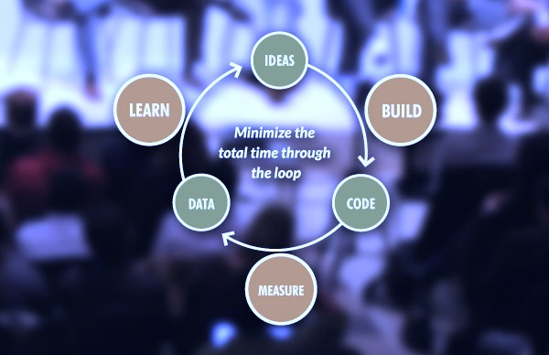
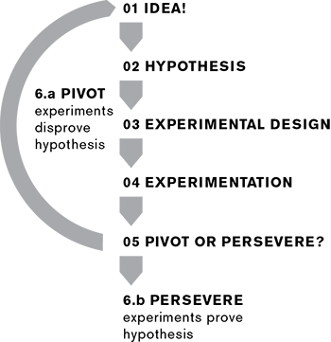
Lean Startup is a learning loop. Pivot until profit.
Continuous Integration and Delivery.
LEARN
BUILD
MEASURE
Notes:
What happened with “statement”?

Slide 14
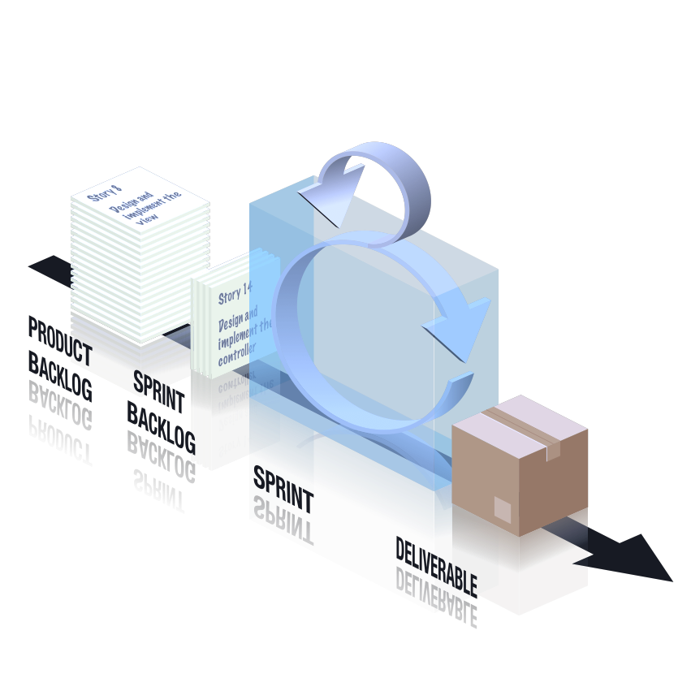
Scrum is double-loop. Learning what to do and how.
Productivity as a deliverable. Continuous improvement.
RETROSPECTIVE
Notes:
What happened with “statement”?

Slide 15
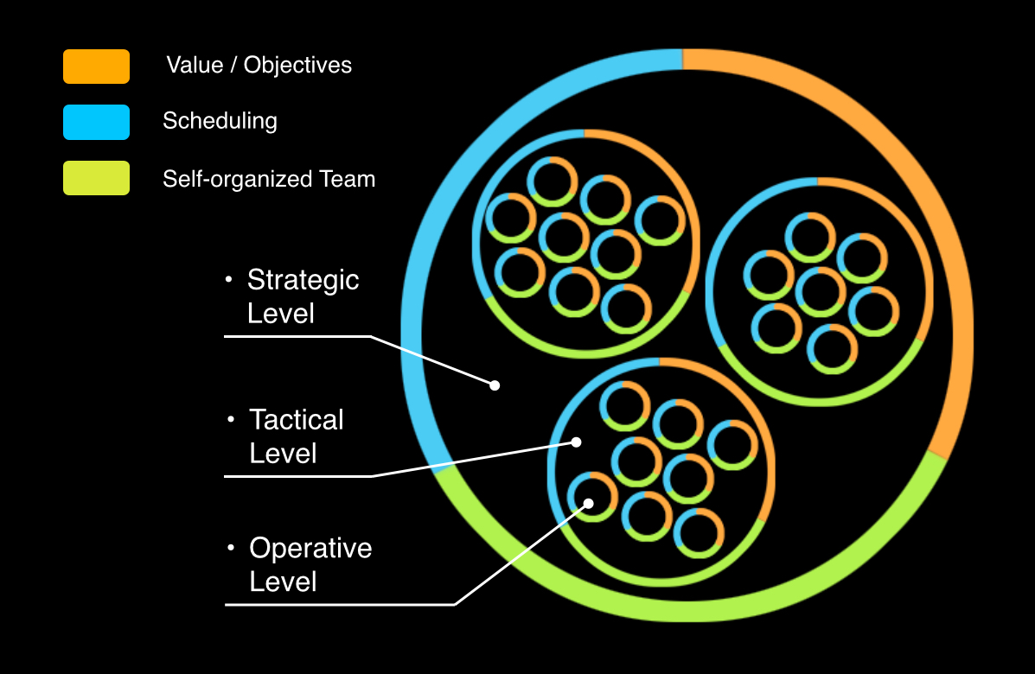
Triple-loop treats the organisation as a deliverable.
Continuous adaptation of teams to products to markets.
Build
Why, Who
& When
Measure
Learn
Value Stream
How Teams
Deliver
Product
Feature
What Teams
Deliver
Notes:
The relationship between process, team structure, and value stream function.
Processes
Impact Mapping
Acceptability Matrix
Backlog Bingo
Release Refactoring
Story Mapping
Scrumban
BDD
CD
Structure
Strategic Execution
Strategy Mapping

Slide 16
Microsoft 2006. Digital but not Agile.
Zune
Internet Explorer
Windows ME/Vista
The Ribbon …

Slide 17
On the way to a “Kodak Moment”?

Slide 18
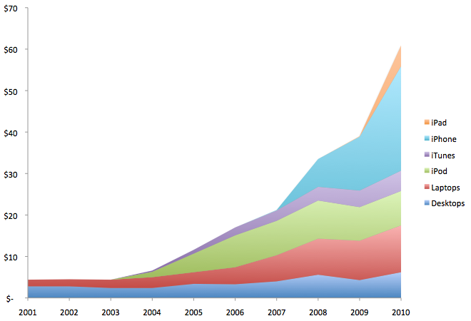
Apple thought different

Slide 19
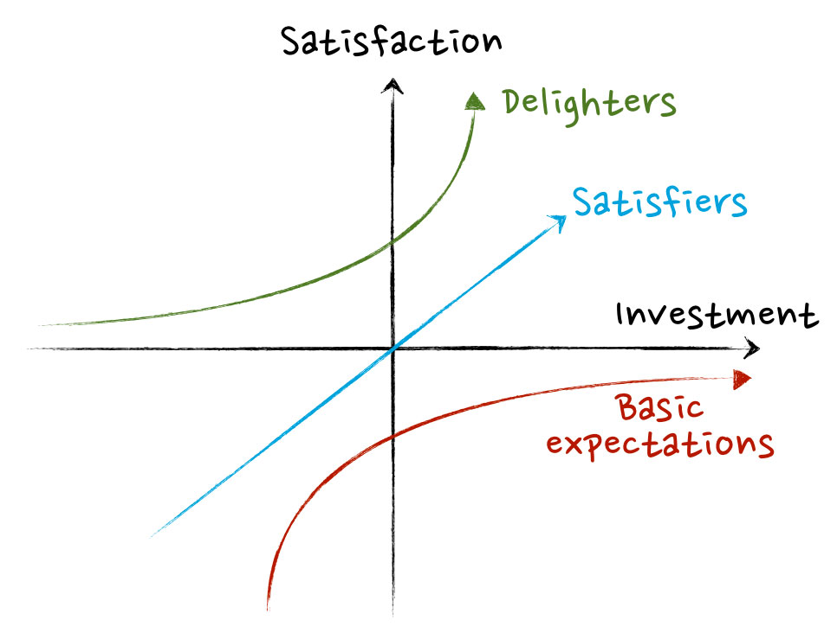
Because Kano
Disruption
Deception
Digitalization
Demonetization
Democratization
Dematerialization
Notes:
What happened with “statement”?

Slide 20
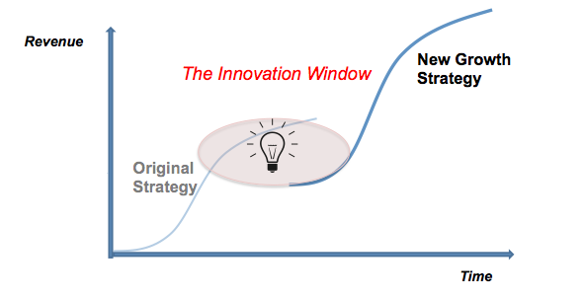
Kodak died staying the course.
Microsoft stagnated meeting the market.
All growth strategies
are S-curves.
Notes:
What happened with “statement”?

Slide 21
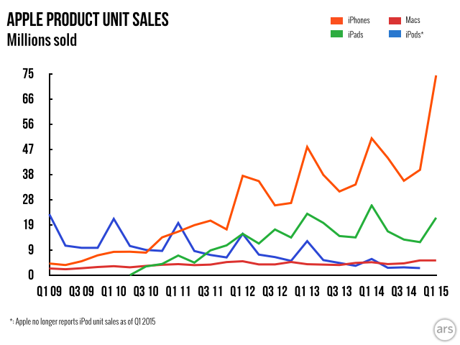
Apple obsoleted the market.
So now it’s worth more than Russia
Notes:
What happened with “statement”?

Slide 22

But this isn’t a delighter.
Notes:
What happened with “statement”?

Slide 23

Now Microsoft is thinking different.
Notes:
What happened with “statement”?

Slide 24
“Microsoft were Digital in 2006. In 2016 the whole
organisation has become Agile.” – Steven Denning

Slide 25

IAG 2009: Digital Competition
Late into digital channels
Losing market share
Losing brand affinity
Ponderous release cycle
Inefficient siloed structure

Slide 26
First Digital Products “Troubled”
1. Home Insurance Sales Online
12 Weeks Late
40% over budget
1394 Defects
“Scrumbut” Process
Confused Project with Product
2. Customer Loyalty Bonus
Agile showed Bus. case flawed
Cancelled without pivoting
Manager scapegoated & sacked
Team member reputations sullied

Slide 27

Why?
Teams mixed progressives & conservatives
Neglected technical enablers
Teams changed process mid-flight
No realistic deployment path
Collisions in shared testing environments
No alignment of organization to Agile
Inadequate executive support
Inadequate cultural awareness

Slide 28


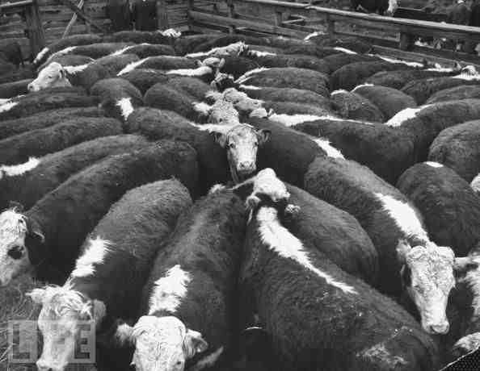
What were we trying to do?
Scaled Agile
Agile Holarchy
Alignment
Waterfall
Waterfall + Agile
Autonomy

Slide 29
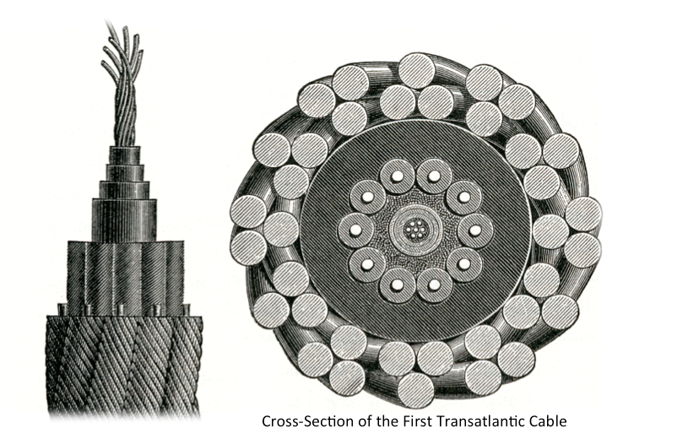
How did we transform?
Start with a metaphor: “steel thread squads”.
Use metrics to prove and grow capability iteratively.
Using Agile to make Agile. No compromise. No confusion.
Notes:
What happened with “statement”?

Slide 30
ALIGN
ASSIST
ACCELERATE
ASSESS
ALLOCATE
APRIL
JULY
SEPTEMBER
FEBRUARY
STRATEGY
COORDINATION
BCF
BCF
BCF
DELIVERY
IRT
IRT
IPH
NCL
IIP
SUPPORT
OPERATIONS
30

Slide 31
CBA 2011: Kaching breaks the mold
Business Issues
Business unprepared for Agile
Negotiation over collaboration
Missing strategic coordination
Business making solution choices
Delivery Team Issues
Sprint over-commitments
Team context-switching
Delivery failing to maintain visibility
No consistent feature estimation process
Technical Issues
Vague & missing acceptance criteria
No mitigation of downstream dependencies
No automated test / environment mgmt

Slide 32
2nd Release A Huge Improvement
400% increase in project throughput over the life of the release.
Project went green across the board in PSG - first time ever.
Project over-delivered – brought 2 significant features forward into the 28.0 release from 28.x (T&Cs, Out-of-App Collections).
R28.0 release on time with no heroics, 26 minor defects assigned to patch, only 1 sev-2 discovered since release
“Kaching For Everyone” – a major new business case initiated, negotiated, detailed and estimated in 28.0 without any disruption to delivery work
Program Manager and Business BAs in collaborative engagement through planning activities at all levels
How?

Slide 33
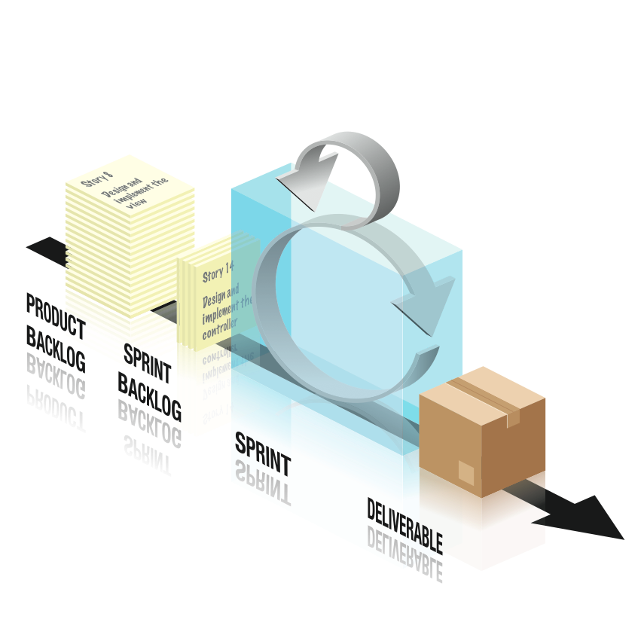
Breadth-first Agile Product Management
Business Case
Stakeholders
CX/UX
Epic list
PRODUCT PLANNING TEAM
IMPACT MAP
& UX DESIGN
FEATURE /
THEME MAP
BUSINESS BINGO ESTIMATION & PRIORITIZATION
RELEASE REFACTORING

Slide 34
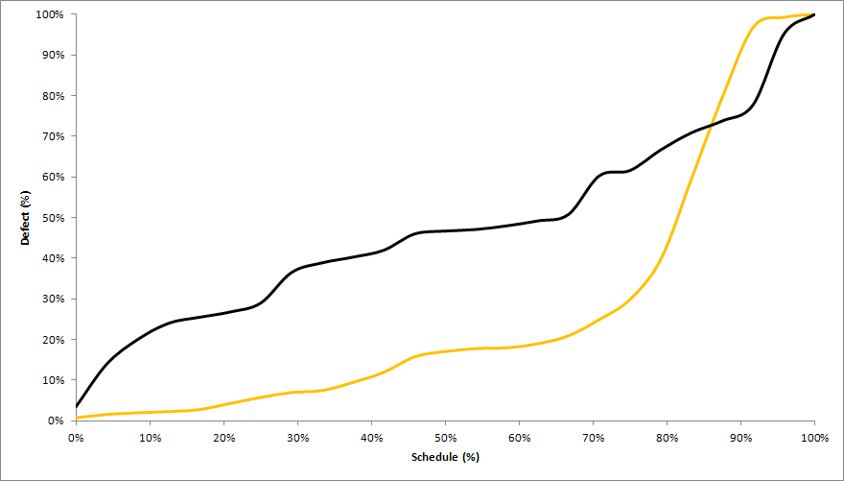
Continuous Integration, Virtual Environments
>50x in prod
“Deferred Quality”
Kaching R28
47%
>25x
All other R28
17%
>10x
>2x
Relative Cost of a Defect
X

Slide 35
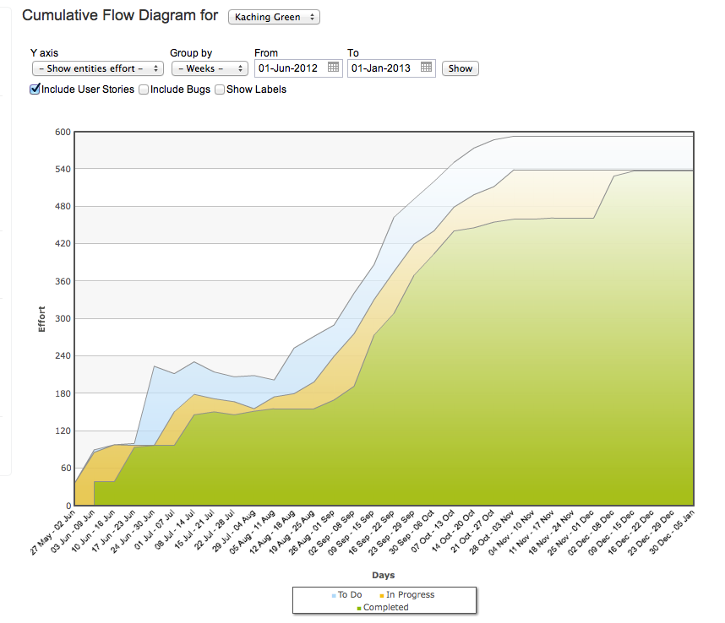
3rd Release: Hot-fix Hell
29.1 Release
28.4 / 29.0 / 29.1 Hotfixing
tracked in QC.
28.1
Patch
28.3 Patch / Hotfix
28.2
Patch

Slide 36
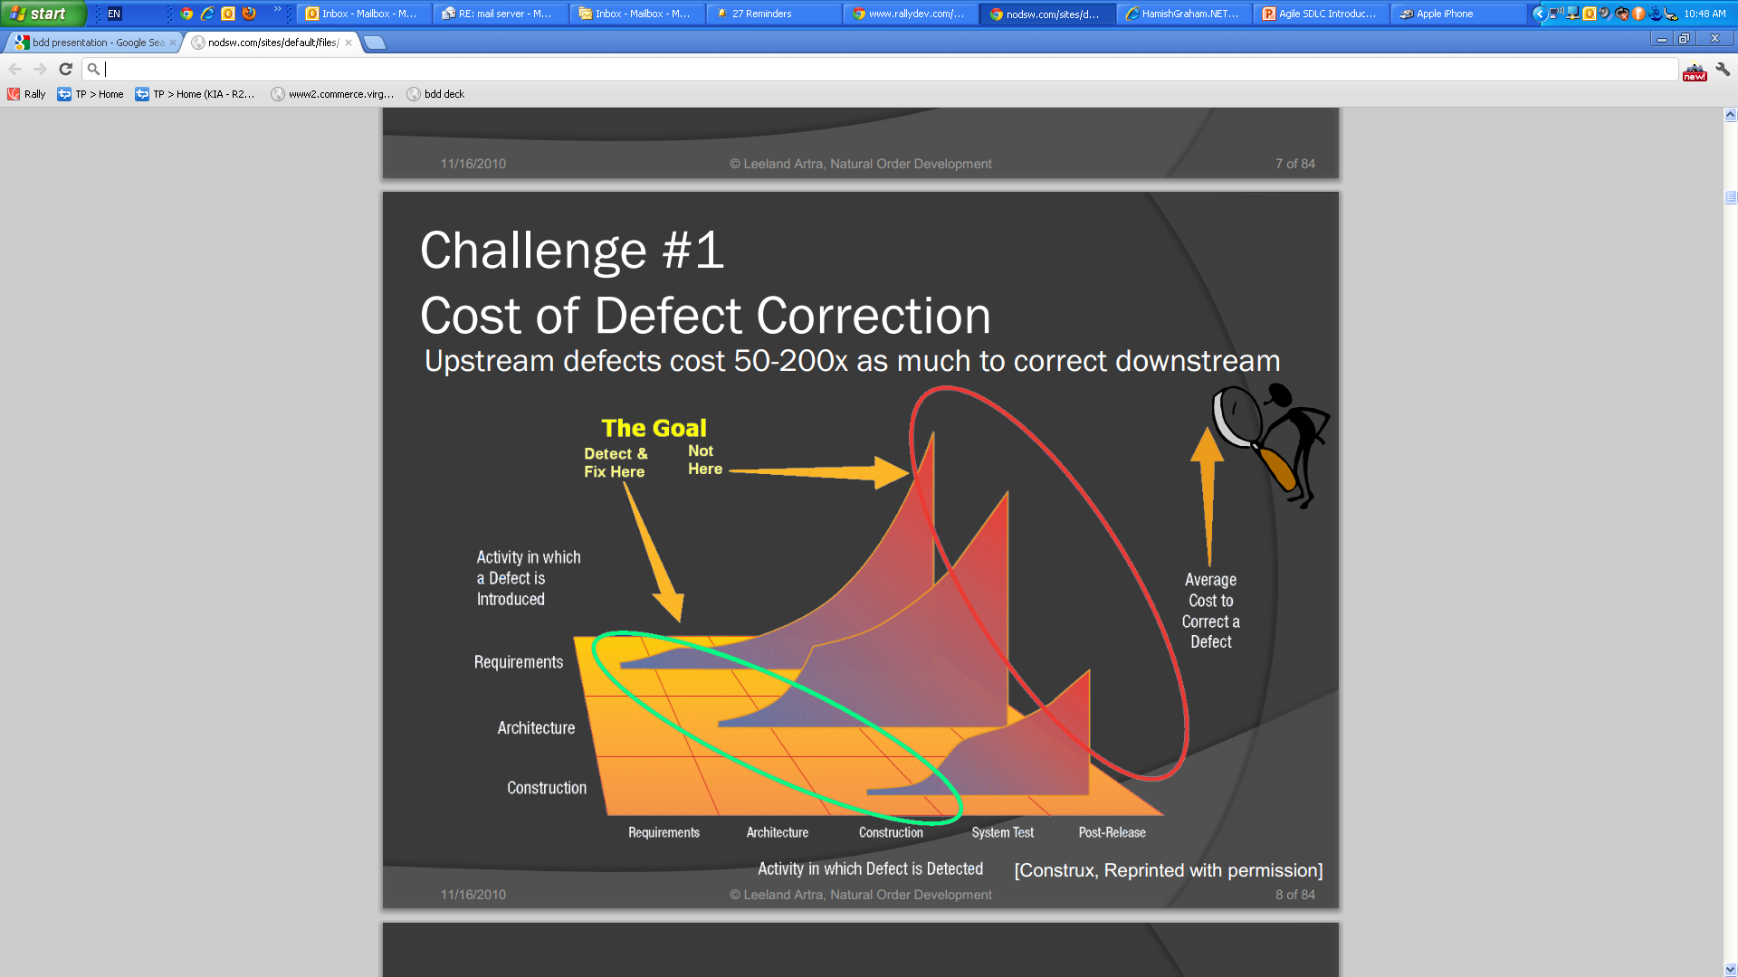
Why?

Slide 37
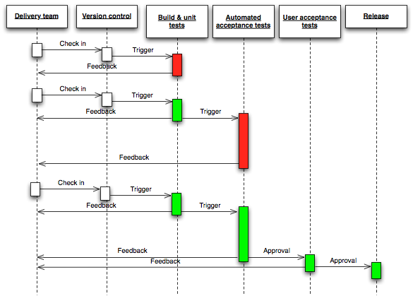
4th Release: Quality Automation
New Test / New Code
Continuous
Integration
Automated
Programmer
Tests
Automated
Acceptance
Tests
Human
Acceptance
Tests
Automated Deployment
BDD
FIT/SIT

Slide 38
4th Release: Quality Automation
New Test / New Code
Continuous
Integration
Automated
Programmer
Tests
Automated
Acceptance
Tests
Human
Acceptance
Tests
Automated Deployment
BDD
FIT/SIT

Slide 39
A $9 Billion Digital Channel
ABFM award for "Most Innovative Retail Banking
Product" 2012, 3 AIMIA awards in 2013 for best app in
Innovation, Effectiveness and Financial Industry, 2012
CIO award for best program in the bank.

Slide 40
Agile approach to project delivery focus on rapidly delivering small incremental features with speed and quality, in order to more effectively respond and adapt to changing business needs
Deliver the highest business value in the shortest time
Deliver incremental releases of working software
Incorporate frequent customer and user feedback as early as practical in the project lifecycle
Continually adapt and learn during the project’s delivery
Work within set incremental timeframes
Earlier delivery of project features & benefits
Reduced cost of delays
Improved quality for the features actually delivered
Products more closely aligned to customer needs
Easier to respond to changing circumstances
Known costs & reduced delivery risk
Focus Areas:
Benefits:
Typically smaller, pilot business cases
Later business cases are lower risk, based on delivery experience
Q1
Q2
Agile Plan
Q4
Q1
Bus Case
Bus Case
Planned
Release
Feature 4
Planned
Release
Feature 1
Planned
Release
Feature 5
Planned
Release
Feature 2
Planned
Release
Feature 6
Planned
Release
Six opportunities to refine based customer data and stakeholder feedback
Feature 3
Opportunities to learn from earlier releases and rework if required.

Slide 41
Delivery using agile requires project teams to learn new concepts, terminology and ways of working, much of which is foreign to traditional project disciplines
Key Agile Concepts:
Product/Release Backlog (the overall wish-list)
Sprint/Iteration (a two week cycle)
Sprint/Iteration Backlog (the priority items for the next few iterations)
Daily Stand-up/Review (no more than 15 minutes)
Showcase Iteration Review (feedback on the product)
Internal Retrospective (fortnightly feedback on process)
Key Agile Roles:
Product Owner (accountable for all product decisions & liaising with external stakeholders)
Scrum-master (facilitates agile processes)
Agile Team/Dev team (all fully committed participants)
Stakeholder (interested parties / occasional attendees / occasional suppliers )
Informed by related concepts & best-practices:
User stories, Use cases
Test-driven development (TDD) & Automated testing
Continuous Integration & Continuous Deployment
Product Visioning through Customer Centred Design (CCD) and Behaviour Driven Design (BDD)
Agile Practices

Slide 42
The agile delivery approach deals with change very effectively
Q1
Q2
Agile Plan
Q4
Q1
Bus Case
Bus Case
Planned
Release
Feature 4
Planned
Release
Feature 1
Planned
Release
Feature 5
Planned
Release
Feature 2
Planned
Release
Feature 6
Planned
Release
Feature 3
Q1
Q2
Actual Scenario
Q4
Org re-structure /
Competitor behaviour /
Regulatory change.
Further initiatives cancelled
Q1
Bus Case
Bus Case
Planned
Release
Feature 4
Planned
Release
Feature 1
Planned
Release
Feature 5
Planned
Release
Feature 2
Planned
Release
Feature 6
Planned
Release
Feature 3
Value still delivered to customer from features 1-4

Slide 43










Given the potential benefits not surprisingly Agile is not just the domain of start-ups… More than 80% of global organisations practice deliver projects using agile approaches.
84% of organisations are delivering projects using Agile approaches
37% of organisations use Agile for ¾ or more of their projects
Many Australian organisations are investing in agility programs:
The top 3 reasons cited for adopting Agile :
accelerating time to market
manage changing priorities
better aligning IT and business objectives
Notes:
Discussion: What are your key drivers for adopting agile?

Slide 44
Agenda
Introduction
The Importance of business agility
Agile delivery – key concepts
Delivering on the promise business agility – key learnings
Agile Transformation - Case Study - Kaching
Approach to agile transformation

Slide 45
Key Learning 1: Agile success places even greater demands on the sponsor and business product owner and their relationship
With less documentation available, the role of the sponsor becomes more important in continually communicating and aligning the product’s strategy and vision
The sponsor needs to be actively involved in the ongoing week-to-week decision-making of the team. Unrealistic stakeholders expectations of delivery can quickly undermine the of Agile approach. (This often occurs when there is a mismatch between “agile as a software development methodology” versus business stakeholder expectations: “I thought I was getting everything delivered faster and cheaper”.)
The Sponsor, Business Product Owner and other key stakeholders need to invest time in their education in understanding the concepts of agile delivery.
There needs to be Clear, effective and trusted delegation from Sponsor to Product Owner

Slide 46
Key Learning 2: Agile success requires that team roles and accountabilities be clearly defined, communicated and agreed:
It is difficult for a project to be successful unless all stakeholders are clear on their responsibilities and accountabilities.
This can often be a challenge in Agile projects; with compressed timeframes, there is less time allocated to wide circulation and approval of documents.
It is essential that team members and stakeholders understand their wider accountabilities both within the project and to external stakeholders. In particular..
:
Document reviews and signoff accountabilities become more important as decisions are made rapidly with less consultation
Defining project roles – the Agile roles of 'Product Owner'; 'Scrum Master' need to be reconciles with traditional project roles.
The role of the Agile Business Analyst in defining and representing Product and Sprint backlog items as delegated Product Owner should be made clear
The essential role of Architects on Agile projects
Making more effective use of test teams on Agile projects

Slide 47
Key Learning 3: Structural and organisational impediments need to be considered for teams to successfully adopt Agile
Governance Compliance & Assurance:
Organisational governance & compliance processes are typically not aligned to Agile development practices. In particular, the governance approaches to stage-gating and go-live requirements often need to change significantly.
With less documentation, “fit for purpose” project assurance and governance reviews become more important - to help re-confirm that projects are delivering to stakeholder expectations
Commercial Impediments:
Commercial constraints & lead times in multi-vendor IT environments need to be addressed head on. Contract and Commercial teams are often not aware of the requirements of agile delivery and hence don’t prioritise these requirements in their negotiations.
Communication and Enterprise Release Mangement
While a single, well-sponsored agile project can often deliver on it’s promised agility… A large portfolio of low-documentation agile projects can quickly create chaos and confusion, and new approaches required to cross-team communication & enterprise release management.

Slide 48
Key Learning 4: Avoiding too much agile jargon facilitates better business engagement
Avoiding the use of jargon. While these terms and roles are important for our internal team and our agile practice, they can be a barrier to understanding - particularly with our wider stakeholders.
Avoid:
Product Backlogs; Sprint backlogs; Release backlogs;
Minimum Viable Proposition
Product Owner
Sprints & Iterations e.g. “16b”
Story points
Velocities
Retrospectives
Scrum Masters
Dev Team (Chickens & Pigs)
Prefer:
Prioritised features for early delivery of benefits
What could we go live with while development continues?
What could we deliver early to help us learn more about our customers?
Who can provide clear day-to-day direction to the team
Agile practices (See appendix)
“Show don’t tell” Stakeholders are likely to be more willing to listen to proof-of-delivery, than in-principle discussions on methodology

Slide 49
Key Learning 5: Investments in better IT development practices are a pre-requisite for successful agile delivery at velocity and scale
Use of agile tools: e.g. Jira, Rally
Collaboration tools: e.g. Confluence
Use of modern languages & frameworks for ‘hotspot’ areas of frequently change.
Automated unit testing and use of dependency injection. Development of Continuous Integration Testing & Continuous Deployment pipelines
Use of modern distributed version control systems
Access to cloud infrastructure
Leverage & service-enable key IT building blocks:
Form capture
Workflow, BPM & imaging
CRM customer master
HR user master
Replace traditional style requirements docs
Enables controlled change & reprioritisation
Avoids email chaos
Greater developer productivity
Enabler for unit test automation (see below)
Automated testing allows every new change and feature to be fully regression tested prior to deployment, massively reducing the risk of unexpected and untested defects.
Essential for maintaining development velocity
Payback / return on investment
Enables developers to more easily work on the same code base in parallel
Significantly lower lead times for establishing & scaling environments
Step change in both:
developer productivity
responsiveness to changing requirements

Slide 50
Agenda
Introduction
The Importance of business agility
Agile delivery – key concepts
Delivering on the promise business agility – key learnings
Agile Transformation - Case Study - Kaching
Approach to agile transformation

Slide 51
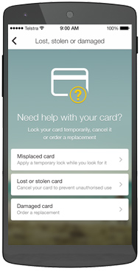
Key Insights on the effective Agile delivery of change – informed by key case studies
Westpac Corporate Online
CBA Kaching
AMP

Slide 52
Agenda
Introduction
The Importance of business agility
Agile delivery – key concepts
Delivering on the promise business agility – key learnings
Agile Transformation - Case Study - Kaching
Approach to agile transformation

Slide 53

Whilst some organisations have chosen to take an ‘all-in’ approach to agile transition and transformation we advocate starting small
Options for transitioning to Agile
Starting Small
Going ‘All In’
Less Expensive
Early success is likely
Less Risk
Less stressful
Obviates need to re-organise
Can reduce resistance
Avoid problems of scrum and traditional teams working together
Implemented more quickly

Slide 54
Our approach to Initial Agile Transition involves a four steps and is founded on a appropriately chosen pilot
1. Current State Diagnostic : Position & Target
Identify & deliver high-priority candidate project to showcase agile delivery approach to senior stakeholders
Identify & document key learnings and any Agility Roadblocks encountered
In-Flight Coaching:
4.Roll-out
Agile Diagnostic & Assessment:
2. Readiness Training
Progressively extend to other teams
Embed agile practices and approaches to internal teams
Stakeholder perceptions of current agility, innovation & speed to market
Current state of agile practice
IT technical readiness (CI/CD/Automation)
Structured Training:
Aligned to globally recognised Scrum Alliance syllabus
Certified Scrum Master, Certified Product Owner
3. Prototype/Pilot
IT & business teams
Agile coaching & support to pilot team, sponsors & stakeholders

Slide 55
The Position and Target Phase sets the scene foundation for Transition and provides early identification of any potential roadblocks
Phase 1: Current State Diagnostic
What is the level of understanding of Agile within the executive management team?
Is the company culture aligned or opposed to Agile values?
Which executive managers would be positive role models for Agile working?
Which progressive team members would be suited to taking part in an Agile pilot
What’s the appetite for change within the organisation as a whole?
Is there a previous experience of Agile transformation within the organisation?
If there was a previous bad Agile experience within the company, what happened? Why?
Are there people whose roles are threatened by Agile principles? Why?
Position
Define and agree the business drivers for Agile transformation
Sell the “need” for change and ensure awareness of the change to key stakeholders
Define and agree specific targets and objectives for return on agility & innovation
Identify a sponsor
Target

Slide 56
To ensure a shared vocabulary and starting point and that team members understand their accountabilities we recommend standardised external training supplemented with on the job coaching support.
Phase 2: Readiness Training
Applied Scrums Team Training
Scrum
Master Training
Product Manager Training

Slide 57

To showcase Agile Delivery & the capability uplift journey requires careful selection of a pilot project and the resources to work on the pilot
Phase 3: Prototype / Pilot
Ensure an appropriate pilot (Duration / Size /Importance / Business Sponsor):
Selecting the best staff for Lead Roles in the Pilot Agile Project
Engage an experienced scrum master and agile coach
Include the Right Product Owner and Business SMEs
Get the team dynamics right
Get the pace of delivery right
Ensure business are engaged and committed
Engage an experienced agile coach and scrum master
Ensure there is adequate training
Record metrics
Market the success
Pilot Team
Pilot Team
Scrum master
Agile coach

Slide 58
Roll-out Phase takes the capability to the wider community and can be achieve by either a ‘split and seed’ or ‘grow and split’ strategy
Phase 4: Roll-Out
Split and Seed
Grow and Split
Pilot Team
Pilot Team
Scrum master
Scrum masters
Scrum master
Agile coach
Agile coach
Scrum master
Scrum master
Agile coach
Agile coach
Scrum master
Agile coach
Scrum master

Slide 59
In our experience a number of factors are critical to the success of agile transition
Critical Success Factors
1.A clear executive mandate
2.The right sponsorship
3.Effective staff engagement
4.The Right Pilot Project
5.The Right Resources
6.Business Buy-In
7. Sufficient Investment
8. Resilience

Slide 60
Thank You

Slide 61
Additional Information
Appendix A: About Mozaic
Appendix B: Further Reading
Appendix C: Sponsor Guidelines
Notes:
Hopefully the preceding discussion gave you a broad brush overview of our capabilities. What I’d like to turn to now is our specific experience in the higher education sector.

Slide 62
Appendix A: About Mozaic 1 of 2
We strive to be the first choice for:
Clients looking for pragmatic ‘fit for purpose, cost effective solutions that deliver demonstrable business value’ and
Affiliates looking for a culture and flexible environment where they can thrive
Our mission
Who we are
Our approach
How we work
We are senior professionals with deep expertise gained in the corporate and professional services world.
Our approach is centered around a “Trusted Partner” Model” - adopting client problems as our own and being passionate about delivering pragmatic solutions that add value.
We take pride in our collaborative approach “teaming” with our clients and creating an environment and culture where our affiliates are passionate about their work and are valued for their contribution..

Slide 63
Appendix A: About Mozaic 2 of 2
We have a broad range of offerings that leverage our collective “Know-how” and the varied experience of our senior professionals.
Project Resourcing
Project Delivery
Project Advisory
Business Advisory
Program Directors
Large Scale Program + Change Management
Project QA
Sourcing Advice
Program Managers
Program Shaping & Planning
Project Maturity Assessments
IT Strategy and Architecture
Business Architects
Operating Model Design and Implementation
PM Capability Uplift
Digital Strategy
Solution Architects
Outsourcing,
cloud Transition
EPMO Design & Implement
Agile Delivery & Transition
Senior Project Managers
PMO Establish + Operate
Business Case Development
Post Merger Integration
Change Managers
PMO Assessment
Package Implementation
Application Portfolio Mgt.
Business Analysts
Shared Service Implementation
Portfolio Planning
Application Competency Centre Design
PMO Resources
PM Coaching
Project Mobilisation
Cloud Assessments
Testing Resources
Digital
Testing Transition
System Selection
Notes:
In the years we have been in business we have performed a wide range of consulting engagements.
What I’ve highlighted in blue are those services that we’ve provided in Higher Ed.
During the case studies I will be drilling down on a number of these areas but happy to answer any specific questions you might have.

Slide 64
Appendix B - Agile Capability & Further Reading
Presentations available
Role of project sponsor - Senior Executive Briefing: Getting the Most out of Agile Projects
Document reviews and signoff accountabilities - The roles of 'Approver', 'Reviewer' and/or 'For Information’; and the implications of delegation.
Defining the Agile roles on the project - how we reconcile the Agile roles of 'Product Owner'; 'Scrum Master' with other traditional project roles defined within our clients.
The role of the Business Analyst in defining and representing Product and Sprint backlog items
The essential role of Architecture on agile projects
Effective use of Test Teams on Agile projects
Change Management and Agile Projects
For more information, we recommend the following reading:
Succeeding with Agile – Mike Cohn
The Limits of Agile (in a mainframe environment), Alan Kelly
Agile in a COBOL World, Roger Brown
Agile Contract Models for external suppliers, Ilan Goldstein
Distributed Scrum Primer for working with offshore teams, Pete Dreemer
Agile Success Factors, Scott Ambler
The Manager and Scrum – Pete Dreemer
What Agile Teams Think of Agile Principles, Laurie Williams
Scrum Guide – the definitive guide to scrum, Ken Schwaber
Scrum Shortcuts without cutting corners, Ilan Goldstein
Use cases are not requirements, Steve Meyer
Evidence based scheduling, Joel Spolsky
The Skeptic’s Guide To Low-Fidelity Prototyping, Laura Busche
Mixing Agile with Waterfall for Code Quality, Ben Linders
Impacts of Organizational Factors on Software Quality, Mathieu Lavallée
Examining the "Big Requirements Up Front Approach” Scott Ambler

Slide 65
Appendix C : Sponsor Guidelines 1 of 2
As an Executive Sponsor : Challenge the Team
Challenge the team’s Release Plan & Approach:
What prototypes could we use to validate requirements or benefit assumptions earlier in the project’s life-cycle, before development commences?
What is the smallest feature set that we could go-live with so that they could solicit feedback?
What could we go live with while development continues?
What could we deliver early to help us learn more about our customers?
What pilot options are there?
Insist on seeing early working prototypes to confirm that they are aligned with your expectations
Attend ‘Sprint Showcases / Iteration Reviews’ where possible, or request separate demonstrations. This is an opportunity to see the raw results of work being achieved; it will give you a better sense of the project’s progress; and an opportunity to communicate priorities and clarify direction.

Slide 66
Appendix C : Sponsor Guidelines 2 of 2
As an Executive Sponsor : Support the Team
Meet with the team both up-front; and on a regular basis to communicate the objectives, background and priority of the project; and the relative priorities of key features
Ensure that you have a sufficiently trusted representative, allocated to the project, if not full-time then at least with sufficient time to provide day-to-day feedback and prioritisation to the team (‘Agile Product Owner’).
Ensure that your day-to-day representative on the project (‘Product Owner’) is aligned with your views of relative priorities of key features. Insist on reviewing these priorities together, in detail.
Be supportive of the team if/when early prototypes fail. These early failures are less expensive and more easily able to be corrected than the failures of traditional-style projects. Ideally these will help the project deliver a better quality outcomes over the course of the project.
Help resolve issues – particularly issues that the team can’t resolve on their own such as availability of key resources, engagement of key suppliers, and priority from other internal supplying teams.
Be clear about the amount of time you personally may (or may not) have available to allocate to the project
Actively endorse the retrospective/learning process (overleaf)

Slide 67
Whilst some organisations have chosen to take an all-in approach to agile transformation we advocate “starting small” on either a visible or stealth project
Options for transitioning to Agile
Starting Small
Going All In
Less Expensive
Early success is likely
Less Risk
Less stressful
Obviates need to re-organise
Can reduce resistance
Avoid problems of scrum and traditional teams working together
Implemented more quickly
?
Visible pilot
Stealth project
Transformations are a complex human activity, multi-dimensional, inherently conflicted and very dynamic. We recommend an “Agile” iterative, progressive approach with adaptive prioritisation

Slide 68
The selection and delivery of the pilot is a key step on the agile journey
Acceleration | Architecture | Assistance | Awareness | Alignment | Assessment
1. Assessment and Alignment- Business Agility Current State Diagnostic
Identify & deliver high-priority candidate project to showcase agile delivery approach to senior stakeholders
Embed agile practices and showcase approach to internal teams.
Identify key learnings
Progressively extend to other teams
4.Document Learnings and Next Steps
Agile Diagnostic & Assessment:
2. Readiness - Training and Coaching
Internal:
Identify & document key learnings and any Agility Roadblocks encountered including
Stakeholder perceptions of current agility, innovation & speed to market
Current state of agile practice
IT technical readiness (CI/CD/Automation)
Structured Training:
Aligned to globally recognised Scrum Alliance syllabus
Certified Scrum Master, Certified Product Owner
3. Showcase Agile Delivery & Capability Uplift
Coaching & Advice:
Agile coaching & support to new teams sponsors & stakeholders
IT & business teams
Process, system, governance, culture

